Slide 1


Rendez-vous and Formation Control for Unicycles via Consensus
Control of Multi-Robot systems
Dipartimento di Ingegneria Informatica, Automatica e Gestionale
Stefano De Filippis
Andrea Tantucci
Andrea Wrona
Professor: Andrea Cristofaro

Slide 2
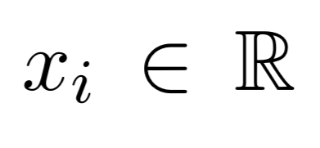
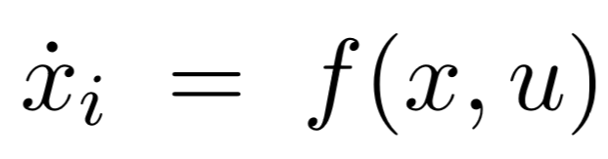
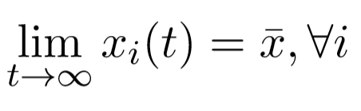
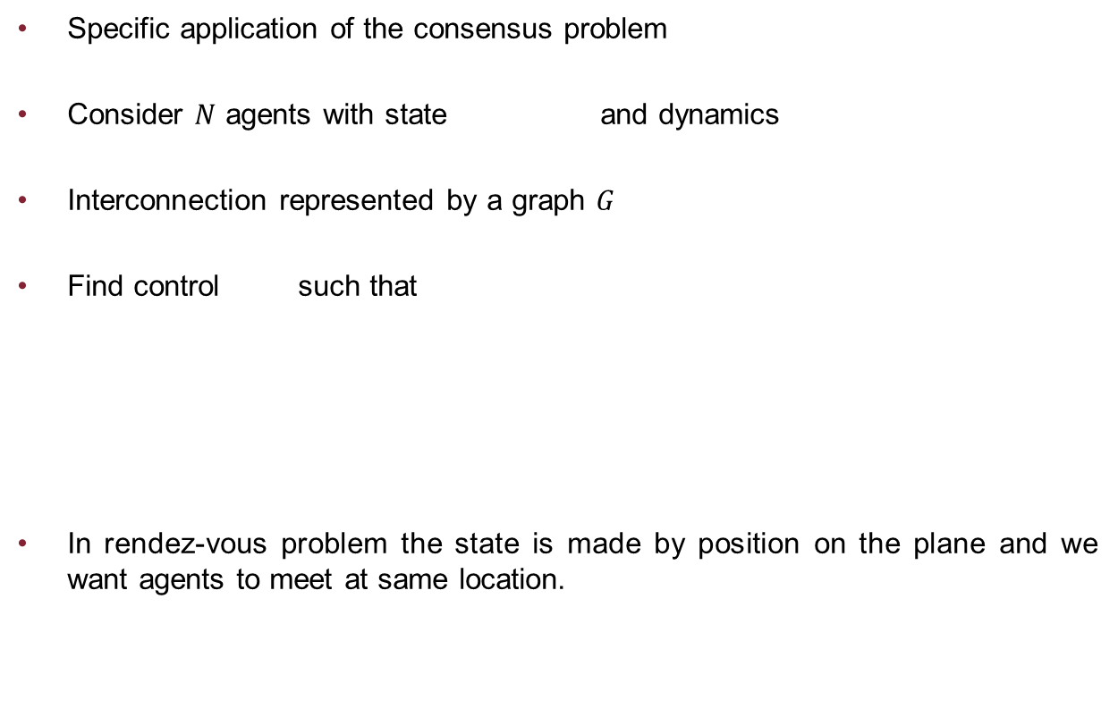
Rendez-vous Problem
Specific application of the consensus problem
Consider $N$ agents with state and dynamics
Interconnection represented by a graph $G$
Find control such that
In rendez-vous problem the state is made by position on the plane and we want agents to meet at same location.

Slide 3
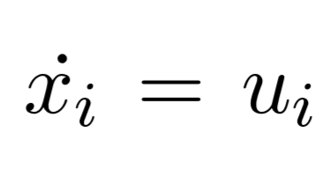
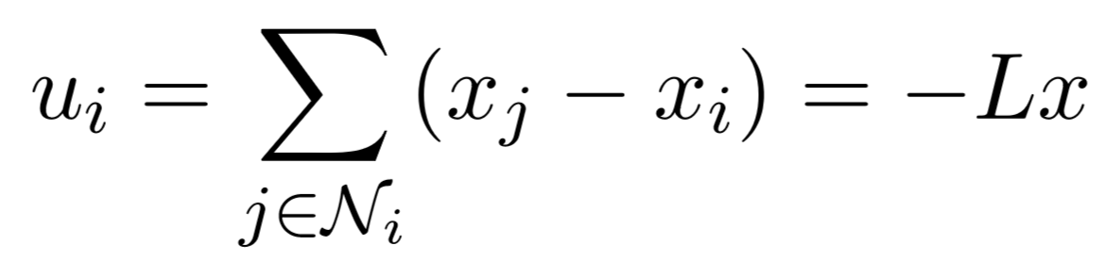
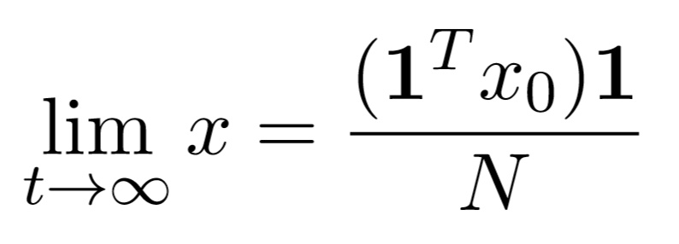
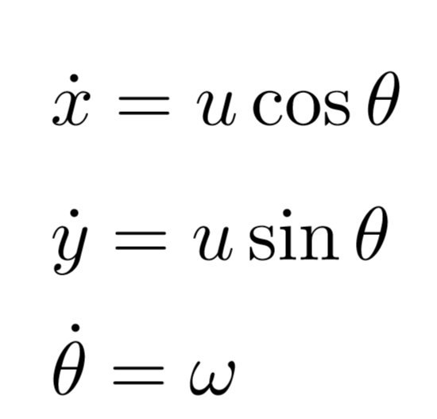
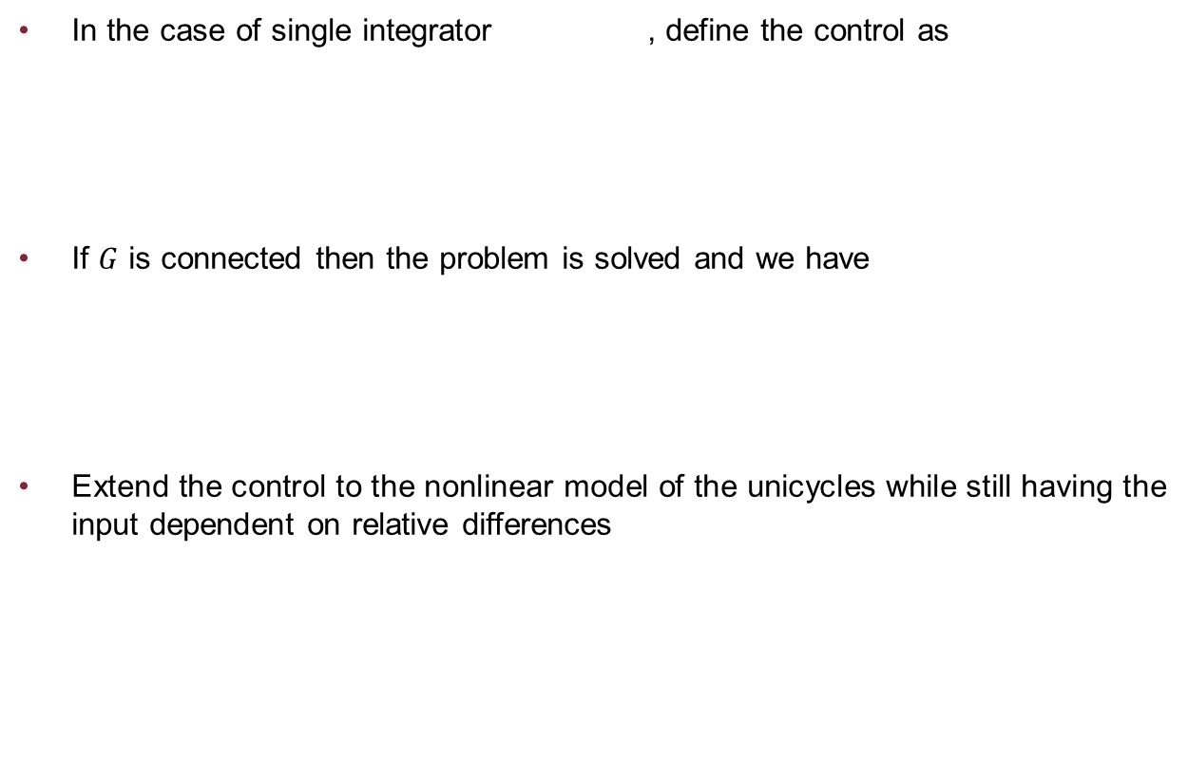
Consensus Protocol
In the case of single integrator , define the control as
If $G$ is connected then the problem is solved and we have
Extend the control to the nonlinear model of the unicycles while still having the input dependent on relative differences

Slide 4
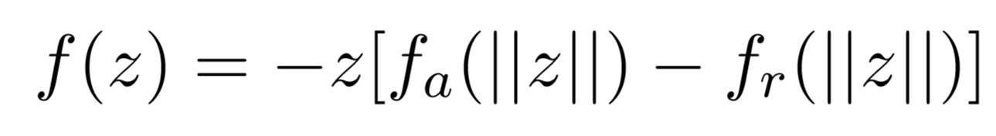
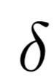
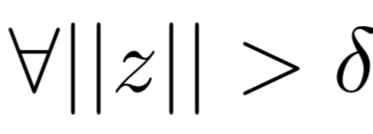
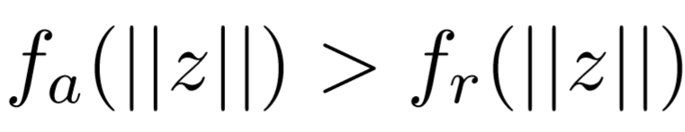
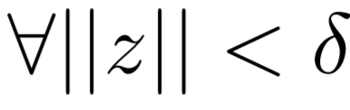
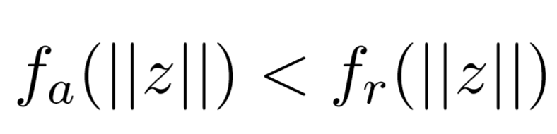
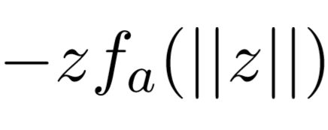
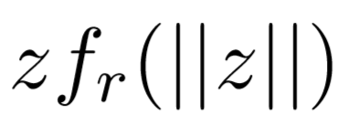
Potential Forces
Control derived by definition of suitable combination of attractive and repulsive forces
There is a unique distance where the forces balance
If then
If then
Actual attractive force and actual repulsive force

Slide 5
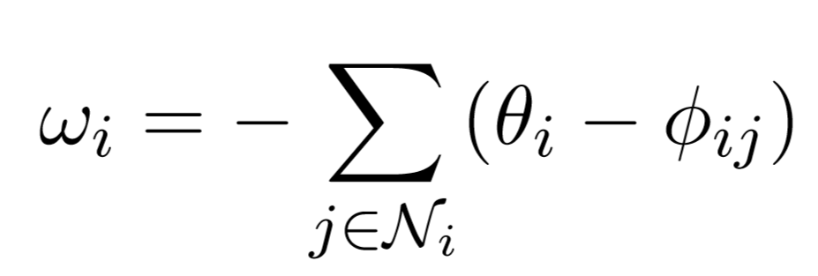
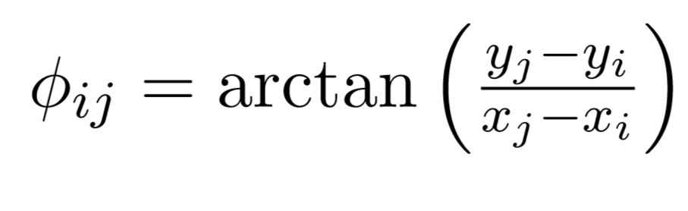
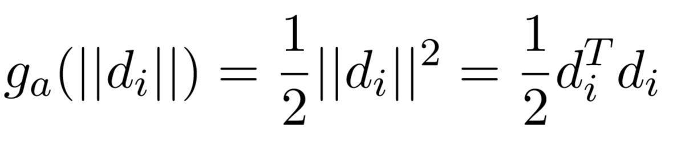
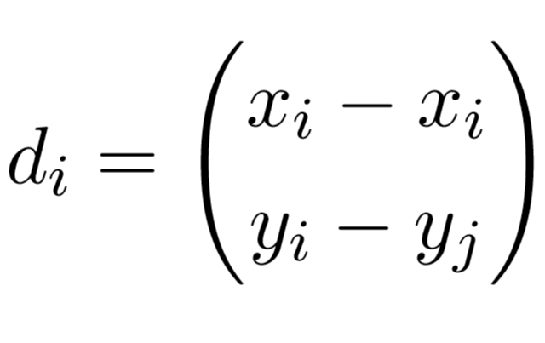
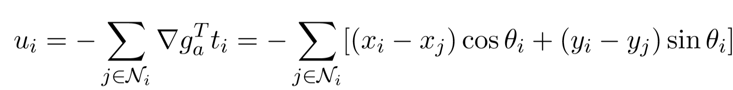
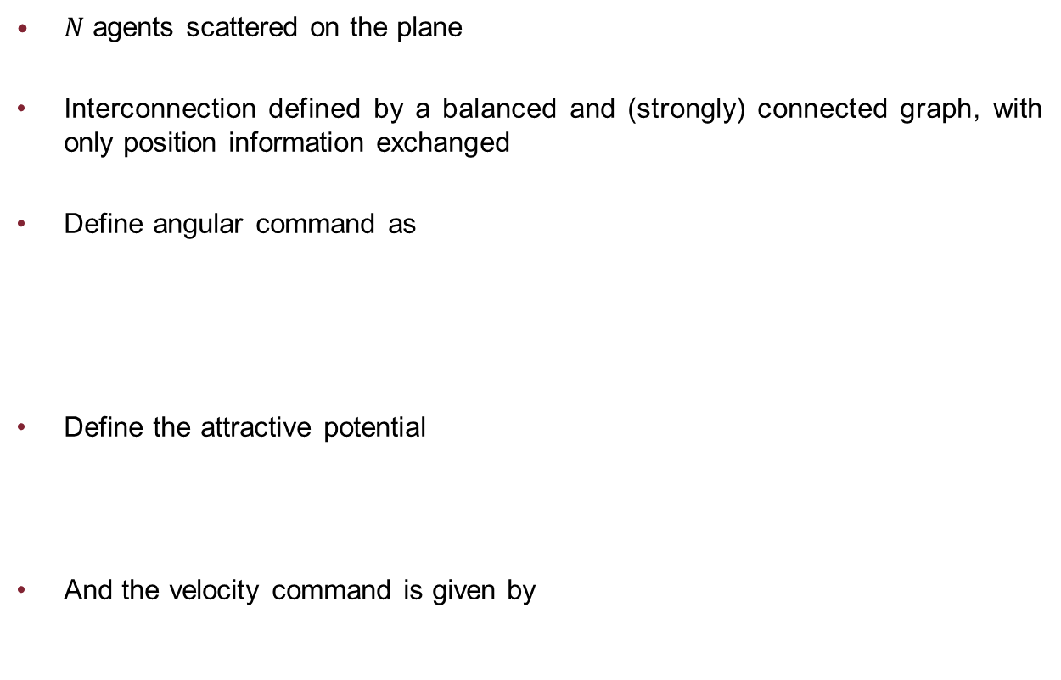
Rendez-vous Controller
$N$ agents scattered on the plane
Interconnection defined by a balanced and (strongly) connected graph, with only position information exchanged
Define angular command as
Define the attractive potential
And the velocity command is given by

Slide 6
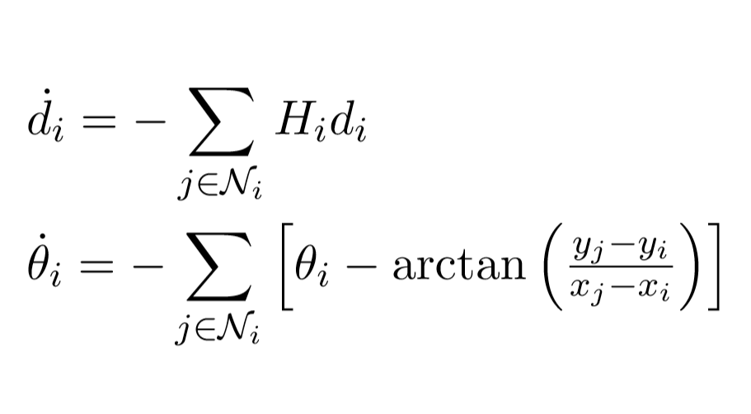
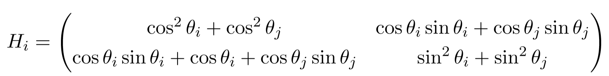
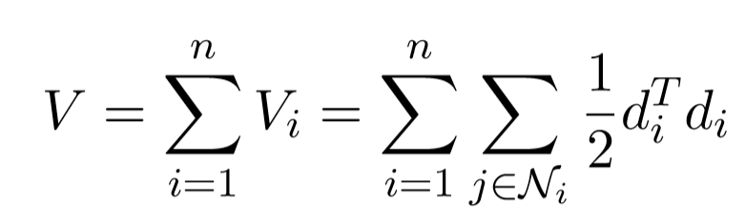
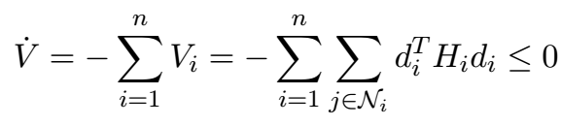
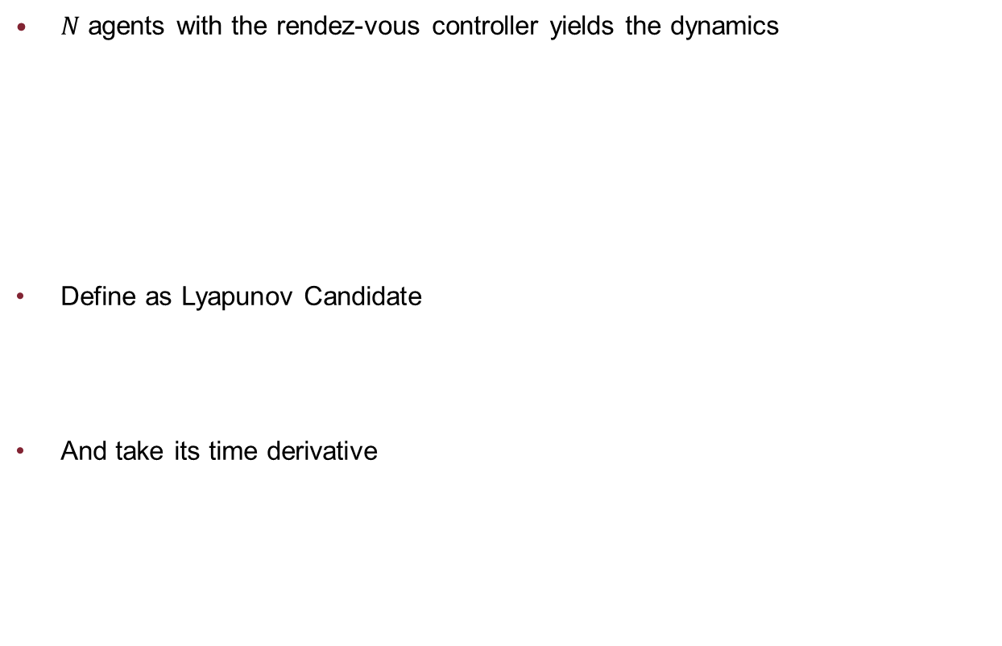
Stability Analysis
$N$ agents with the rendez-vous controller yields the dynamics
Define as Lyapunov Candidate
And take its time derivative

Slide 7
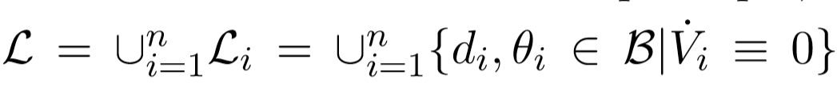
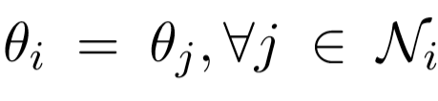
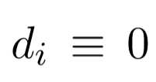
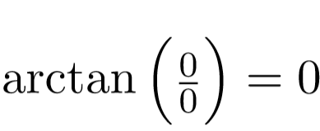
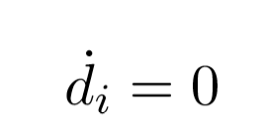
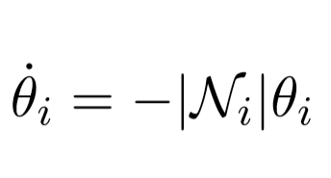
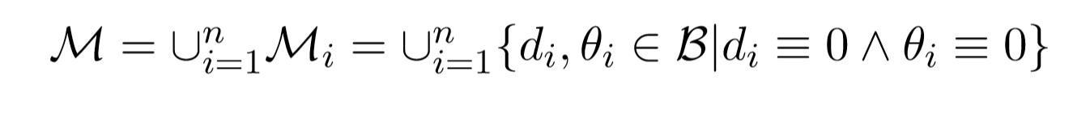
Stability Analysis
Use LaSalle-Krasovskii invariance principle and constraint the aggregate system to
First case: but dynamics does not remain inside the set
Second case: and defining results in
And so the “theta” subsystem is asymptotically stable and converges to zero
Largest invariant set is

Slide 8
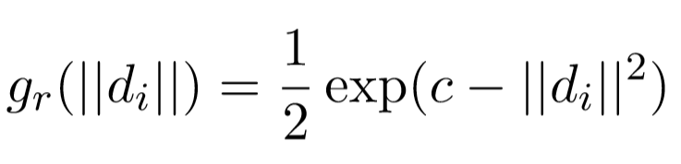
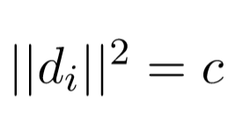
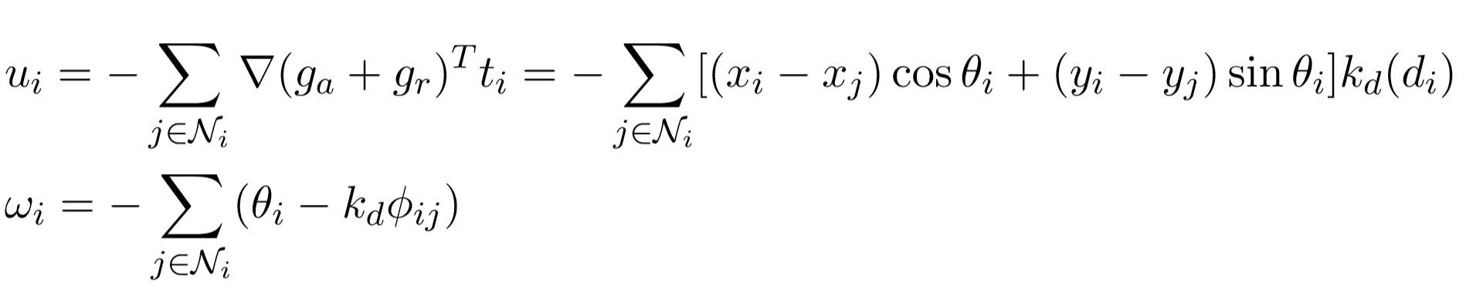
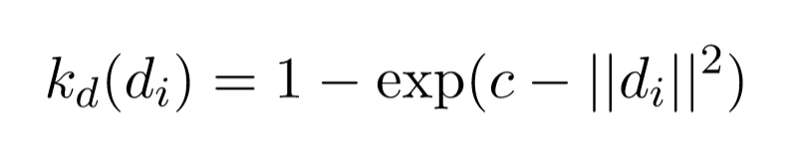
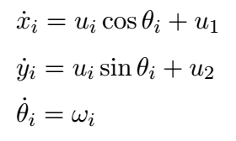
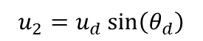
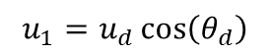
Formation Control
Add a repulsive term
The balance of the two forces happens when , the new equilibrium
The new control law is given by
Add two control channels to make the unicycles execute the travel
$$u_{1}=u_{d}\cos\left(θ_{d}\right)$$
$$u_{2}=u_{d}\sin\left(θ_{d}\right)$$

Slide 9
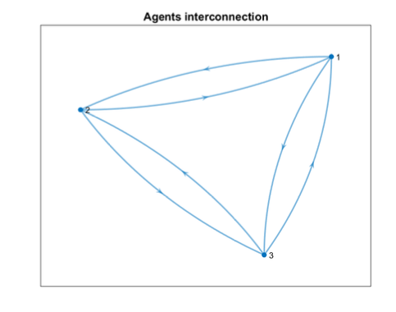
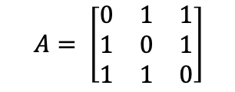
3 agents – Graph structure
The network is built in such a way that every agent can communicate with the other ones, i.e. the edges are bidirectional.
Adiancency Matrix
$$A= \left[\begin{matrix}0 & 1 & 1 \\ 1 & 0 & 1 \\ 1 & 1 & 0\end{matrix}\right]$$

Slide 10
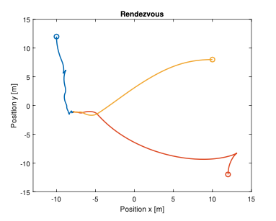
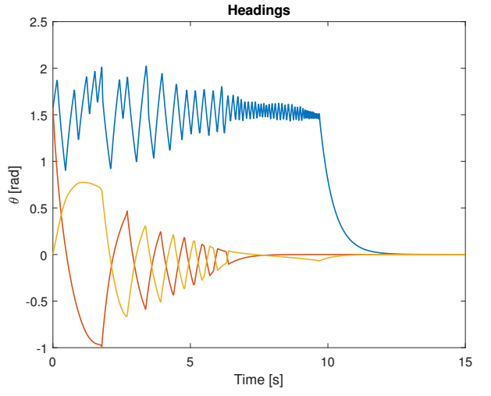
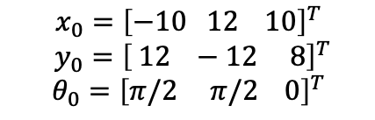
3 agents – Rendez-vous
Initial Conditions
$$x_{0}={\left[−10 12 10\right]}^{T}$$
$y_{0}={\left[ 12 −12 8\right]}^{T}$
$$θ_{0}={\left[π/2 π/2 0\right]}^{T}$$

Slide 11
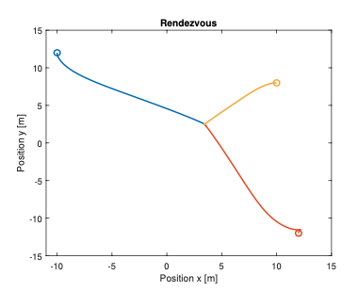
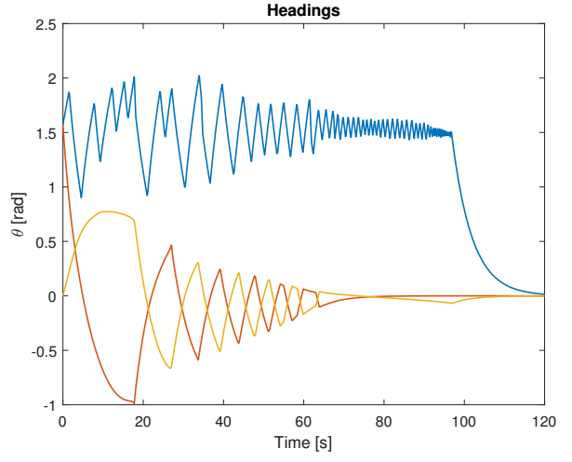
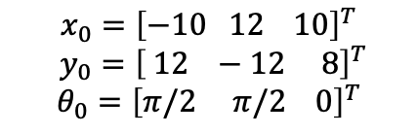
3 agents – Rendez-vous with weighted control
$$x_{0}={\left[−10 12 10\right]}^{T}$$
$y_{0}={\left[ 12 −12 8\right]}^{T}$
$$θ_{0}={\left[π/2 π/2 0\right]}^{T}$$
Initial Conditions
Weight
k = 0.1

Slide 12


3 agents – Rendez-vous Control Efforts
Control effort without weight
Control effort with weight

Slide 13




3 agents – Formation Control
$$x_{0}={\left[−10 12 10\right]}^{T}$$
$y_{0}={\left[ 12 −12 8\right]}^{T}$
$$θ_{0}={\left[π/2 π/2 0\right]}^{T}$$
$$u_{d}=0$$
$$θ_{d}=0$$
$$d=\sqrt{c}=7$$
Initial Conditions
Desired values

Slide 14

3 agents – Formation Control

Slide 15

4 agents – Graph structure
The network structure has been modified, so that one robot can send information only to another one.
The agents which do not communicate (two couples) will not maintain the desired distance in the formation control.

Slide 16


4 agents – Rendez-vous
Initial conditions

Slide 17


4 agents – Formation control
Design parameters
$$d=12 \left[m\right], u_{d}=0.9 \left[\frac{m}{s}\right], θ_{d}=\frac{π}{4} \left[rad\right]$$

Slide 18

4 agents – Movie

Slide 19

5 agents – Graph structure
As before, one robot can send information only to another one.
The agents which do not communicate will not maintain the desired distance in the formation control.

Slide 20


5 agents – Rendez-vous
The trajectories the unicycles have to follow in order to perform the rendez-vous are unrealistic;
The control law is not feasible from a physical point of view.
The solution is to add a weight on the control, slowing down the transient

Slide 21


5 agents – Formation control
Design parameters
$$d=5 \left[m\right], u_{d,x}=3.8 \left[\frac{m}{s}\right], u_{d,y}=0.8 \left[\frac{m}{s}\right], θ_{d}=\frac{t}{7} \left[rad\right]$$

Slide 22

5 agents – Movie

